Slide 1

AirBNformed:
Accurate Rental Price Prediction on Airbnb
Elham Nabipoorafruzi
Notes:
Hi my name is Elham, what I want to present to you today, is AirBNformed, an app which accurately predicts Airbnb rental prices

Slide 2


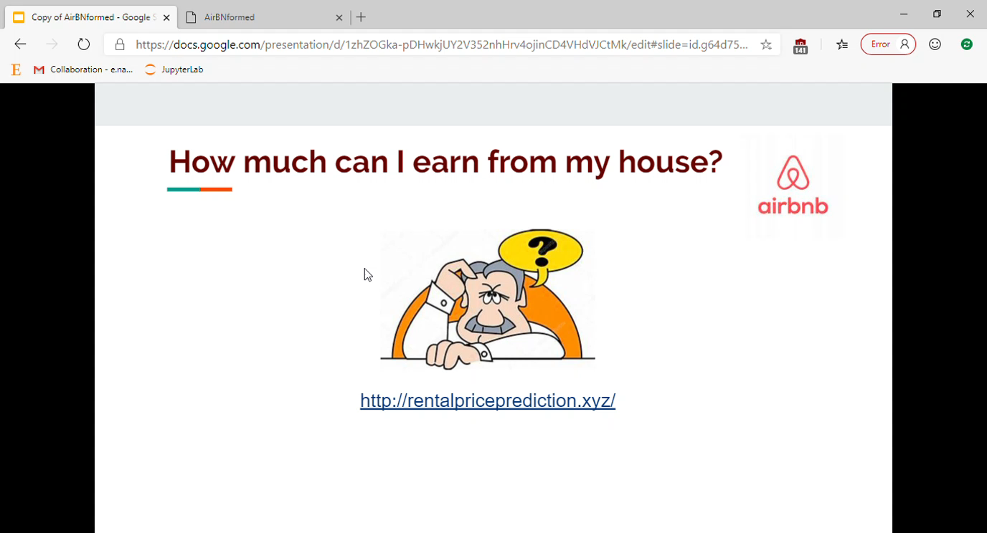
How much can I earn from my house?
http://rentalpriceprediction.xyz/
Notes:
This is Mr. Brown. He has a property. He wanted to rent it on Airbnb but he does not know how much he will earn by doing it.
So, he chekced Airbnb and there were many different houses with different features. So, he got confused because he couldn’t find a house similar to his own house based on its features and location.
To solve his problem, I have developed a web app that helps him estimate his monthly income. In this page he can enter the information about his house and by clicking the predict button he can see his income prediction per month.

Slide 3
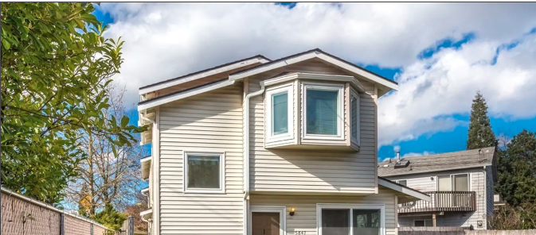

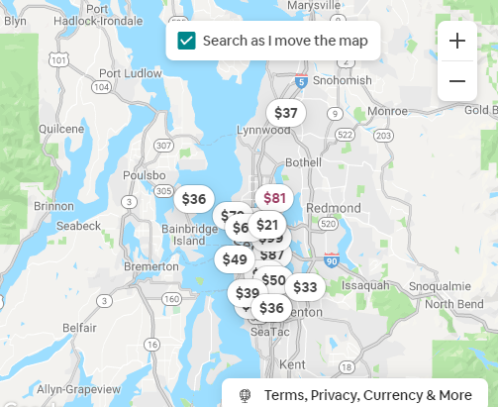


Data
Seattle:
16213 Houses
364 Features
House
Location
Host
Notes:
Let’s see how it works. The data that I have worked on is form Insideairbnb website. Because we live in Seattle, I chose Seattle for which we have 16213 houses and 364 features.
These features can be divided into 3 groups. First, the features related to the house itself, for example number of bathrooms and its amenities. Second, the features related to its location, like its neighborhood and zip code. Third, the features related to the host like where the location of the host is or how responsive s/he is.

Slide 4
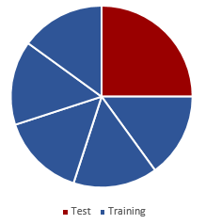
Algorithms and Validation
25%
75/25 train/test split
Grid search and cross validation to tune model
Stacking to combine model predictions
Algorithm | MAE ($) | Adjusted R²
Random Forest | 1002 | 0.61
XGBoost | 1074 | 0.55
CATBoost | 953 | 0.63
Stacking | 392 | 0.91
Notes:
After cleaning and preparing the dataset, I separated 25% of the data for testing. I used three regression models in parallel using grid search and 5-fold cross validation on the remaining 75%.
Finally, stacking has been performed to combine the predictions obtain by the models.
The result of our models which are: Random Forest, CATBoost and XGBoost are shown in this table based on the values of MAE and adjusterd R^2. So, we obtained 91% adjusterd R^2 from this stacking.

Slide 5
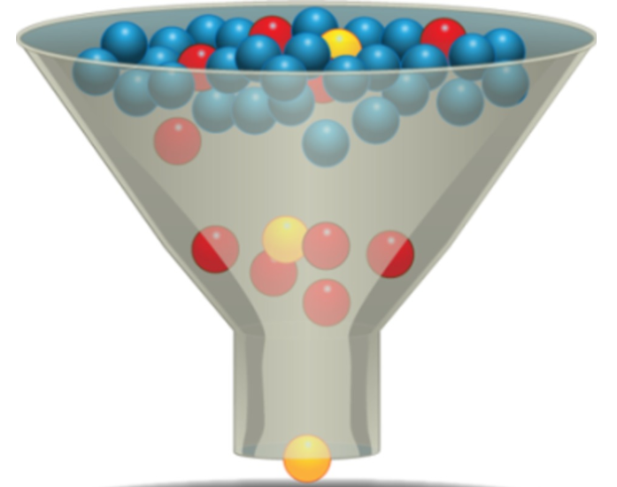

Feature Selection
364 Features
Algorithm | MAE ($) | Adjusted R²
Random Forest | 997 | 0.65
XGBoost | 1029 | 0.62
CATBoost | 990 | 0.62
Stacking | 424 | 0.90
28 final features
14%
Notes:
Because the user cannot enter so many features to see the predictions, based on the result of the model, I have selected the most important features which in total gave me more than 70% gain in comparison to each original models.
So, the number of features reduced to 28. After feature selection, running the models and stacking again, here is the final result. Based on the fact that the average income from houses is about 3000$ per month, we have 14% error in our prediction.

Slide 6








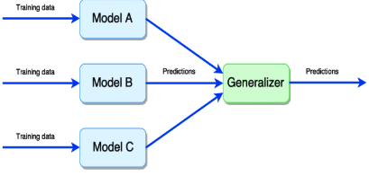
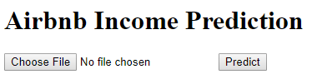

Data Pipeline
Models + Parameter tuning and Validation
Feature Selection
Notes:
Here is the pipeline of this project from where the data started, to an interface that generates an accurate prediction of how much one can earn from his/her property.
There were many challenges in this project but data cleaning has been the most challenging part. There were a lot of features with NaN or only one value. A lot of features had high correlation with others.
There were a lot of values with extra characters which had to be fixed. Many dummy variables were created not only based on categorical features but also features which had a list for their value.
Aggregation was another challenge because I had multiple monthly snapshot of the listings so I had manually aggregate each feature for each property.

Slide 7

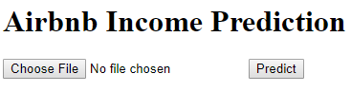

Problem Solving
Notes:
So, now by using this product Mr. Brown can plan for his future. Because he is able to know how much he can earn currently, and also he can check which changes can increase that money. So he is happy now!

